Slide 1
Graphs +
Shortest Paths
Thanks to David Kauchak

Slide 2
All Pairs Shortest Paths and Floyd-Warshall Algorithm
CLRS 25.2

Slide 3
All-pairs shortest paths
Given a weighted directed graph, G(V, E) with a weight function w that maps edges to real-valued weights.
  w(u,v) denote the weight of an edge (u,v)
For every pair of vertices u, v, find a shortest path from u to v, where the weight of a path is the sum of the weights of the edges along the path.
  Run Dijkstra’s algorithm V times?
  O(V E log V) if no negative weights

Slide 4
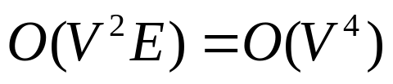
All-pairs shortest paths
If we allow negative edge weights but no negative-weight cycles
  Cannot use Dijkstra’ algorithm
  Run Bellman-Ford once for each vertex, which leads to a running time of
  for a dense graph.

Slide 5


All-pairs shortest paths
Instead, we will use a dynamic programming solution:
  Floyd-Warshall Algorithm
  Running time:
Let denote the weight of the shortest path from u to v

Slide 6
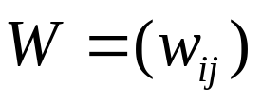
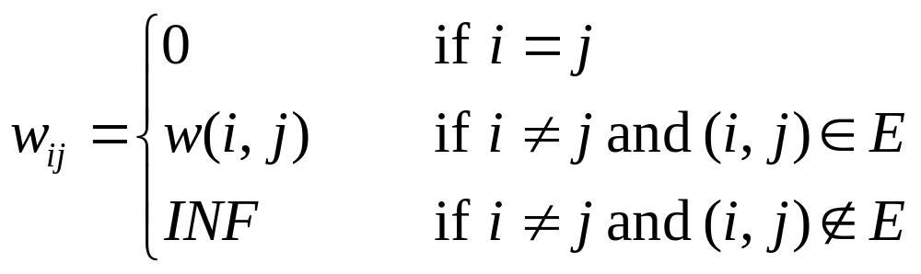
Input: adjacency matrix representing G
Assume an adjacency matrix representation
  Assume vertices are numbered 1,2,…,n
  The input is a n x n matrix representing the edge weights of an n-vertex directed graph

Slide 7
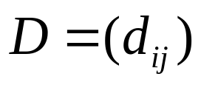
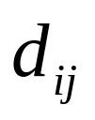
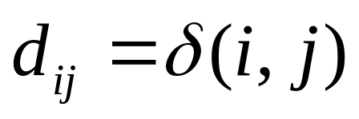
Output?
n x n matrix
Entry will contain the weight of the shortest path from vertex i to vertex j, that is

Slide 8
Example: input
2
W
4
3
1 2 3 4 5
1
2
3
4
5
0 | 3 | 8 | ∞ | -4
∞ | 0 | ∞ | 1 | 7
∞ | 4 | 0 | ∞ | ∞
2 | ∞ | -5 | 0 | ∞
∞ | ∞ | ∞ | 6 | 0
1
8
3
2
-4
1
-5
7
5
4
6

Slide 9
Example: output
2
D
4
3
1 2 3 4 5
1
2
3
4
5
0 | 1 | -3 | 2 | -4
3 | 0 | -4 | 1 | -1
7 | 4 | 0 | 5 | 3
2 | -1 | -5 | 0 | -2
8 | 5 | 1 | 6 | 0
1
8
3
2
-4
1
-5
7
5
4
6

Slide 10
Example: output
2
D
4
3
1 2 3 4 5
1
2
3
4
5
0 | 1 | -3 | 2 | -4
3 | 0 | -4 | 1 | -1
7 | 4 | 0 | 5 | 3
2 | -1 | -5 | 0 | -2
8 | 5 | 1 | 6 | 0
1
8
3
2
-4
1
-5
7
5
4
6

Slide 11
Example: output
2
D
4
3
1 2 3 4 5
1
2
3
4
5
0 | 1 | -3 | 2 | -4
3 | 0 | -4 | 1 | -1
7 | 4 | 0 | 5 | 3
2 | -1 | -5 | 0 | -2
8 | 5 | 1 | 6 | 0
1
8
3
2
-4
1
-5
7
5
4
6

Slide 12
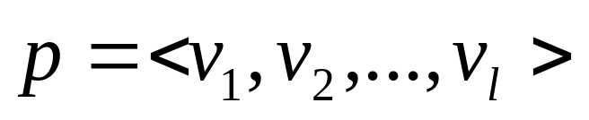
DP Formulation
Intermediate vertices: on a path
any vertex other than the first and the last vertices is called and intermediate vertex.
Let vertices of G be V={1,2,….,n}
Consider a subset {1,2,…,k} of these vertices for some k
Subproblems: limit the set of intermediate vertices on a path from i to j to subset {1,2,…,k}
  The path is allowed to pass through only vertices 1 through k

Slide 13
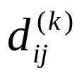

DP Formulation
In the original problem: For any pair of vertices i and j, the intermediate vertices could be drawn from the set {1,…,n}
Define to be the shortest path from i to j such that intermediate vertices on the path are drawn from the set {1,2,…,k}
  Matrix

Slide 14
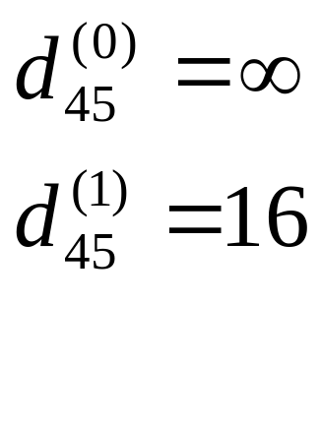
Example
2
4
3
1
8
3
2
14
1
-5
7
5
4
6

Slide 15
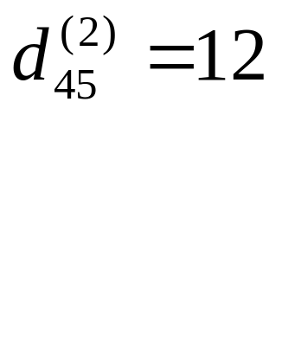
Example
2
4
3
1
8
3
2
14
1
-5
7
5
4
6

Slide 16
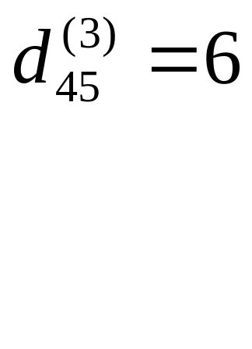
Example
2
4
3
1
8
3
2
14
1
-5
7
5
4
6

Slide 17
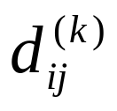

DP Formulation
How to reduce to smaller problems? i.e. how to compute assuming we have already computed ?

Slide 18
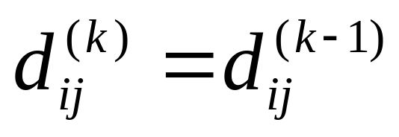
DP Formulation
How to reduce to smaller problems? i.e. how to compute assuming we have already computed ?
Two cases:
  Case 1: Vertex k is NOT among the intermediate vertices on the shortest path from i to j

Slide 19
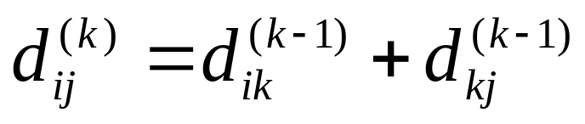
DP Formulation
Case 2: Vertex k is an intermediate vertex on the shortest path from i to j
  First take the shortest path from i to k using intermediate vertices from the set {1,2,…,k-1}
  Then take the shortest path from k to j using intermediate vertices from the set {1,2,…,k-1}
k
i
j

Slide 20
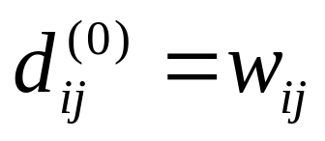
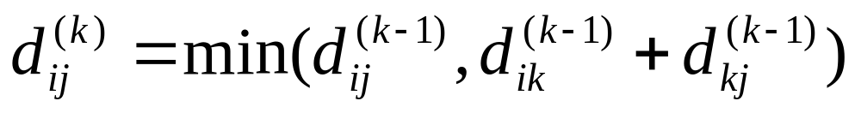
DP Formulation
Base case:
Recursive definition (for k > 0)

Slide 21
All pairs shortest path
The problem: find the shortest path between every pair of vertices of a graph
The graph: may contain negative edges but no negative cycles
A representation: a weight matrix where
W(i,j)=0 if i=j.
W(i,j)=∞ if there is no edge between i and j.
W(i,j)=“weight of edge”
Note: we have shown principle of optimality applies to shortest path problems
Floyd’s Algorithm <number>
Notes:
Algorithms
CS333 / class 22

Slide 22
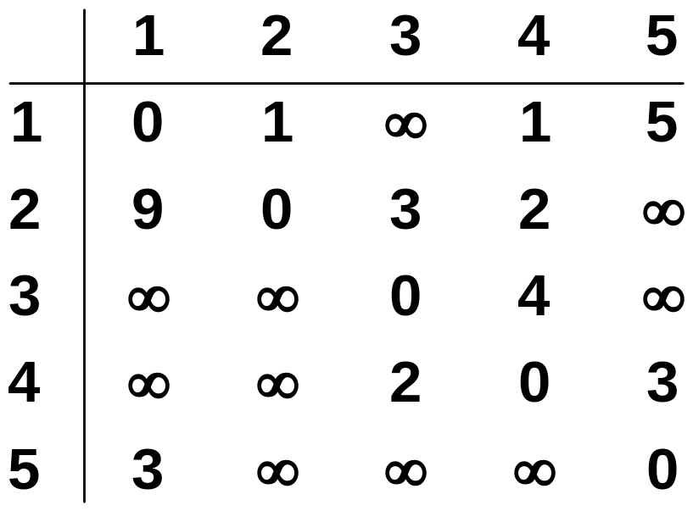
The weight matrix and the graph
1
3
v₁
v₂
9
5
1
2
3
v₅
3
2
v₄
v₃
4
Floyd’s Algorithm <number>
Notes:
Algorithms
CS333 / class 22

Slide 23
The subproblems
How can we define the shortest distance d_{i,j} in terms of “smaller” problems?
One way is to restrict the paths to only include vertices from a restricted subset.
Initially, the subset is empty.
Then, it is incrementally increased until it includes all the vertices.
Floyd’s Algorithm <number>
Notes:
Algorithms
CS333 / class 22

Slide 24
The subproblems
Let D^{(k)}[i,j]=weight of a shortest path from v_{i} to v_{j} using only vertices from {v₁,v₂,…,v_{k}} as intermediate vertices in the path
  D⁽⁰⁾=W
  D^{(n)}=D which is the goal matrix
How do we compute D^{(k)} from D^{(k-1)} ?
Floyd’s Algorithm <number>
Notes:
Algorithms
CS333 / class 22

Slide 25
The Recursive Definition:
Case 1: A shortest path from v_{i} to v_{j} restricted to using only vertices from {v₁,v₂,…,v_{k}} as intermediate vertices does not use v_{k}. Then D^{(k)}[i,j]= D^{(k-1)}[i,j].
Case 2: A shortest path from v_{i} to v_{j} restricted to using only vertices from {v₁,v₂,…,v_{k}} as intermediate vertices does use v_{k}. Then D^{(k)}[i,j]= D^{(k-1)}[i,k]+ D^{(k-1)}[k,j].
Shortest path using intermediate vertices
{V₁, . . . V_{k} }
V_{k}
V_{j}
V_{i}
Shortest Path using intermediate vertices { V_{1, . . .} V_{k -1} }
Floyd’s Algorithm <number>
Notes:
Algorithms
CS333 / class 22

Slide 26
The recursive definition
Since
D^{(k)}[i,j]= D^{(k-1)}[i,j] or
D^{(k)}[i,j]= D^{(k-1)}[i,k]+ D^{(k-1)}[k,j].
We conclude:
D^{(k)}[i,j]= min{ D^{(k-1)}[i,j], D^{(k-1)}[i,k]+ D^{(k-1)}[k,j] }.
Shortest path using intermediate vertices
{V₁, . . . V_{k} }
V_{k}
V_{j}
V_{i}
Shortest Path using intermediate vertices { V_{1, . . .} V_{k -1} }
Floyd’s Algorithm <number>
Notes:
Algorithms
CS333 / class 22

Slide 27


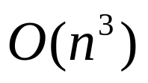
Floyd-Warshall Algorithm
Floyd-Warshall(W) {
n = rows[W]
for k=1 to n do
for i=1 to n do
for j=1 to n do
return
}

Slide 28
Example
2
4
3
1 2 3 4 5
1
2
3
4
5
0 | 3 | 8 | ∞ | -4
∞ | 0 | ∞ | 1 | 7
∞ | 4 | 0 | ∞ | ∞
2 | ∞ | -5 | 0 | ∞
∞ | ∞ | ∞ | 6 | 0
1
8
3
2
-4
1
-5
7
5
4
6

Slide 29

Example
2
4
3
1 2 3 4 5
1
2
3
4
5
0 | 3 | 8 | ∞ | -4
∞ | 0 | ∞ | 1 | 7
∞ | 4 | 0 | ∞ | ∞
2 | 5 | -5 | 0 | -2
∞ | ∞ | ∞ | 6 | 0
1
8
3
2
-4
1
-5
7
5
4
6

Slide 30

Example
2
4
3
1 2 3 4 5
1
2
3
4
5
0 | 3 | 8 | 4 | -4
∞ | 0 | ∞ | 1 | 7
∞ | 4 | 0 | 5 | 11
2 | 5 | -5 | 0 | -2
∞ | ∞ | ∞ | 6 | 0
1
8
3
2
-4
1
-5
7
5
4
6

Slide 31

Example
2
4
3
1 2 3 4 5
1
2
3
4
5
0 | 3 | 8 | 4 | -4
∞ | 0 | ∞ | 1 | 7
∞ | 4 | 0 | 5 | 11
2 | -1 | -5 | 0 | -2
∞ | ∞ | ∞ | 6 | 0
1
8
3
2
-4
1
-5
7
5
4
6

Slide 32

Example
2
4
3
1 2 3 4 5
1
2
3
4
5
0 | 3 | -1 | 4 | -4
3 | 0 | -4 | 1 | -1
7 | 4 | 0 | 5 | 3
2 | -1 | -5 | 0 | -2
8 | 5 | 1 | 6 | 0
1
8
3
2
-4
1
-5
7
5
4
6

Slide 33

Example
2
4
3
1 2 3 4 5
1
2
3
4
5
0 | 1 | -3 | 2 | -4
3 | 0 | -4 | 1 | -1
7 | 4 | 0 | 5 | 3
2 | -1 | -5 | 0 | -2
8 | 5 | 1 | 6 | 0
1
8
3
2
-4
1
-5
7
5
4
6

Slide 34
Space Requirement
Do we need n matrices, each of n x n?
  One n x n matrix for D is enough!
  In phase k, it is okay to overwrite the D from the previous phase (k-1)
  Why?

Slide 35
Floyd-Warshall Algorithm
Floyd-Warshall(W) {
n = rows[W]
for i=1 to n do
for j = 1 to n do
D[i,j] = W[i,j]
for k=1 to n do
for i=1 to n do
for j=1 to n do
if (D[i,k]+D[k,j] < D[i,j])
D[i,j]=D[i,k}+D[k,j]
return D
}

